Slide 1
8051 MICROCONTROLLER

Slide 2
What is a microcontroller?
A microcontroller is a small, low-cost computer-on a-chip which usually includes:
An 8 or 16 bit (CPU).
A small amount of RAM.
Programmable ROM and/or flash memory.
Parallel and/or serial I/O.
Timers and signal generators.
Analog to Digital (A/D) and/or Digital to Analog (D/A) conversion.

Slide 3
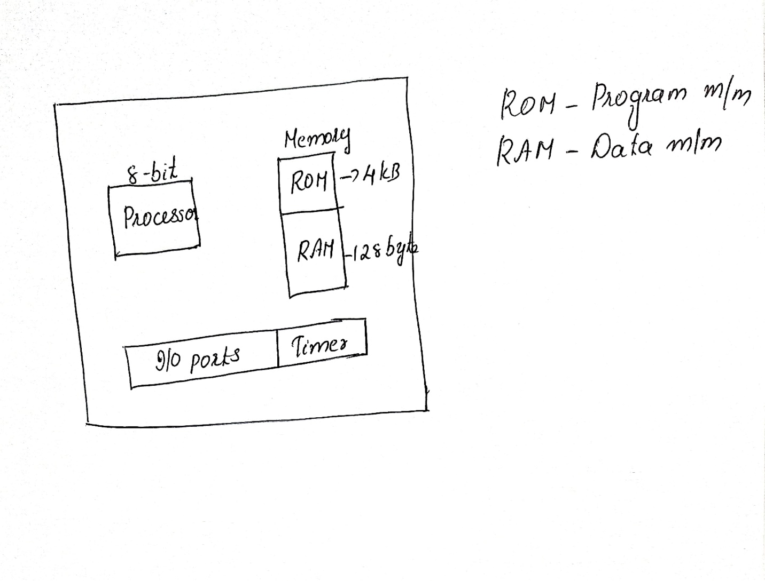

Slide 4
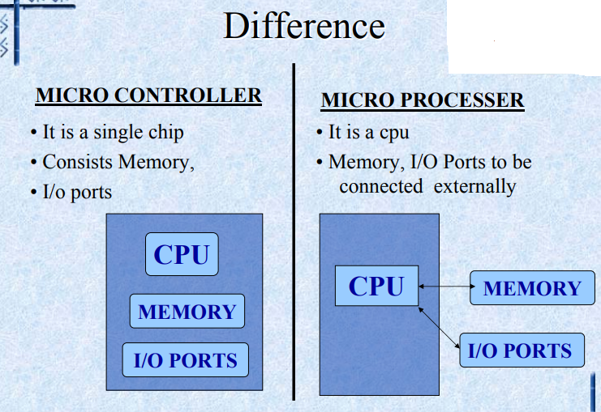

Slide 5
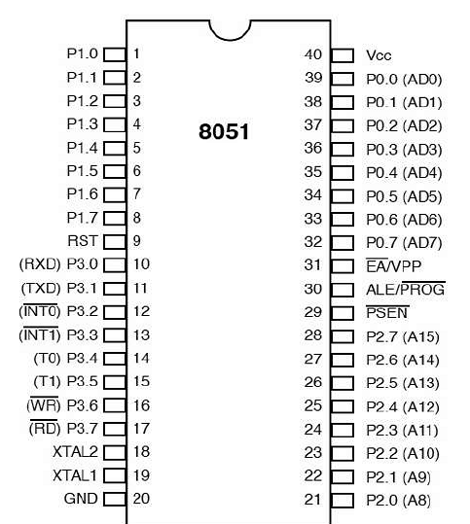
Pin Diagram of 8051

Slide 6
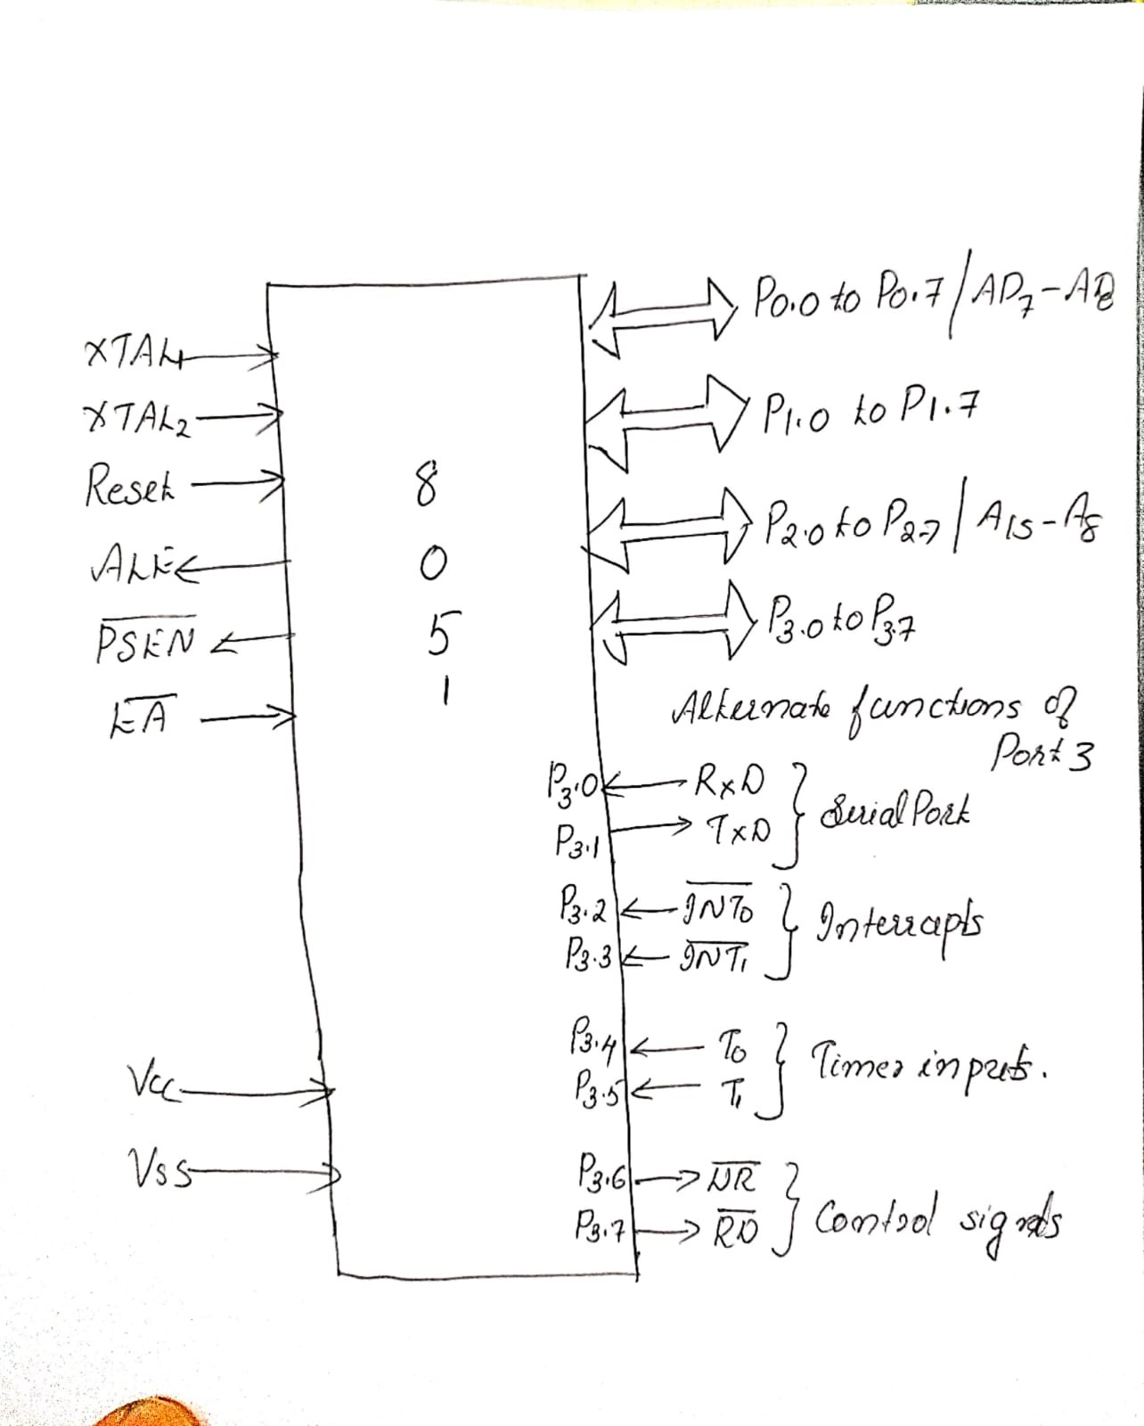


Slide 7
Pins 1 to 8 − These pins are known as Port 1. This port doesn’t serve any other functions. It is internally pulled up, bi-directional I/O port.
Pin 9 − It is a RESET pin, which is used to reset the microcontroller to its initial values.
Pins 10 to 17 − These pins are known as Port 3. This port serves some functions like interrupts, timer input, control signals, serial communication signals RxD and TxD, etc.
Pins 18 & 19 − These pins are used for interfacing an external crystal to get the system clock.
Pin 20 − This pin provides the ground supply to the circuit.
Pins 21 to 28 − These pins are known as Port 2. It serves as I/O port. Higher order address bus signals are also multiplexed using this port.

Slide 8
Pin 29 − This is PSEN pin which stands for Program Store Enable. It is used to read a signal from the external program memory.
Pin 31 − This is EA pin which stands for External Access input. It is used to enable/disable the external memory interfacing.
Pin 30 − This is ALE pin which stands for Address Latch Enable. It is used to demultiplex the address-data signal of port.
Pins 32 to 39 − These pins are known as Port 0. It serves as I/O port. Lower order address and data bus signals are multiplexed using this port.
Pin 40 − This pin is used to provide power supply to the circuit.

Slide 9
8051 Internal Architecture
The 8051 architecture include
8 bit CPU
Memory
Four 8 bit I/O
Two 16 bit timers/counters
Universal Asynchronous Receiver Transmitter(UART)

Slide 10
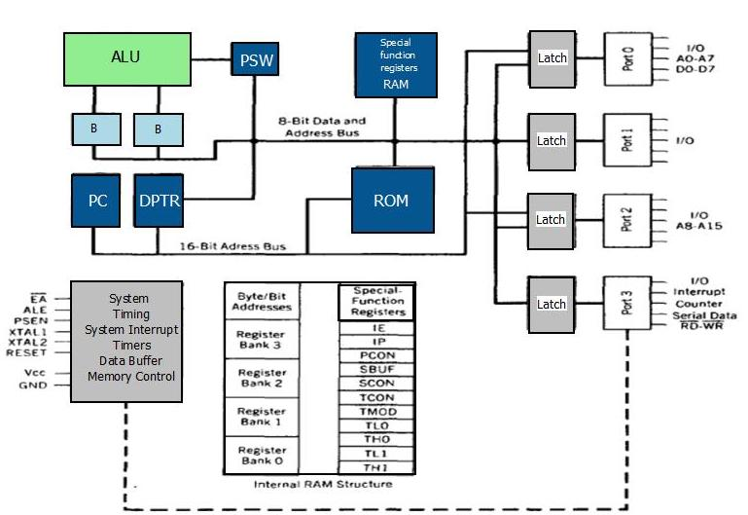

Slide 11
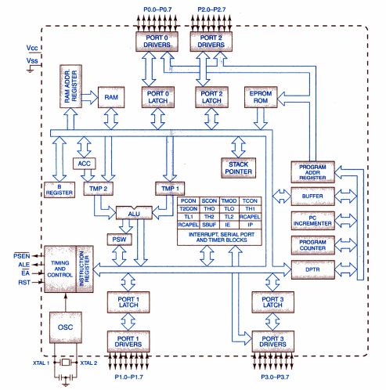

Slide 12
8051 Internal Architecture
PROCESSOR
The processor includes
Arithmetic and Logic Unit
Instruction Decoder and Timing Generation Unit
Accumulator
B register and status register

Slide 13
8051 Internal Architecture
ARITHMETIC AND LOGIC UNIT
The accumulator is an 8 bit register
In arithmetic and logic operations, one of the operands is in ‘A’ register
INSTRUCTION DECODER AND CONTROL
Decodes the instructions and establish the sequence of events to flow
TIMING GENERATION UNIT
Synchronizes all the microcontroller operations with the clock
Generates control signals necessary for communication between the microcontroller and peripherals

Slide 14
8051 Internal Architecture
CPU REGISTERS
Accumulator (E0 H) register :-
The accumulator is an 8 bit register
In arithmetic and logic operations, one of the operands is in ‘A’ register
After the arithmetic and logic operations, the result is stored in A register.
B (F0 H) register :-
8 bit register used during multiply and divide operations
In multiplication operation,the higher byte of the result is in ‘B’ register
In division operation 8 bit divisor is in ‘B’ register and then remainder is stored in ‘B’ register

Slide 15
CPU Registers
Program Status Word (D0 H) (Flag Register)
8 bits wide, but only 6 bits of it are used
remaining two unused bits are user-definable flags
From the 6 bits, the 4 of them are conditional flags-
CY [carry]
AC [auxiliary carry]
P [Parity]
OV [overflow].
other 2 bits are designated as RS0 and RS1, and are used to change the bank registers

Slide 16
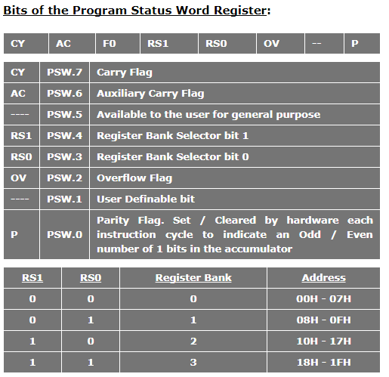
FORMAT OF PSW

Slide 17
8051 MEMORY ORGANIZATION
divided into
Program Memory and
Data Memory
Program Memory (ROM) is used for permanent saving program being executed
Data Memory (RAM) is used for temporarily storing and keeping intermediate results and variables.

Slide 18
8051 PROGRAM MEMORY (ROM)
Program Memory (ROM) is used for permanent saving program (CODE) being executed.
8051 memory organization allows external program memory to be added.
If EA=0 , the microcontroller completely ignores internal program memory and executes only the program stored in external memory.
If EA=1 In this case, the microcontroller executes first the program from built-in ROM, then the program stored in external memory.

Slide 19
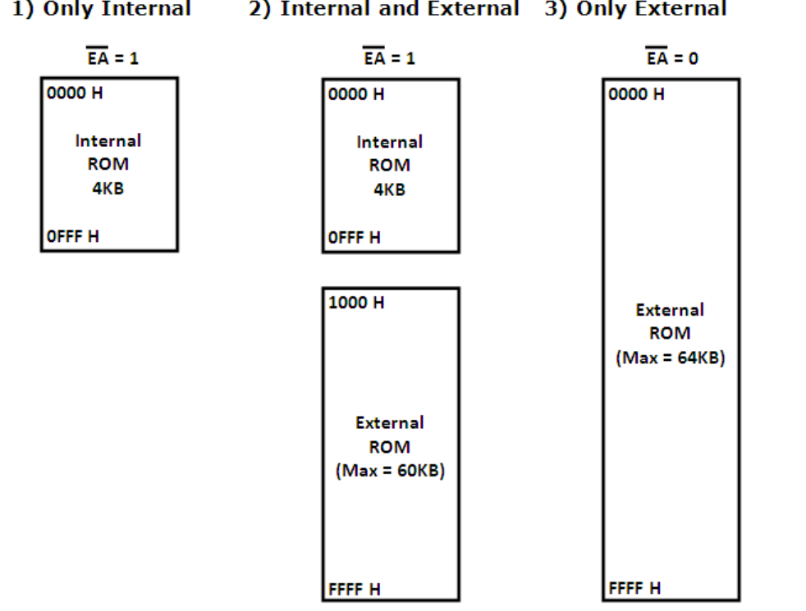
8051 MEMORY ORGANIZATION

Slide 20
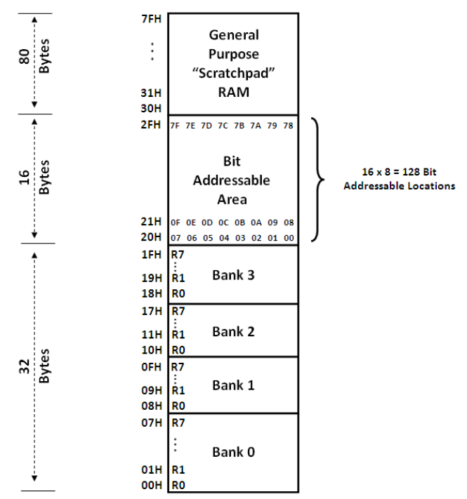
Structure of Internal RAM of 8051

Slide 21
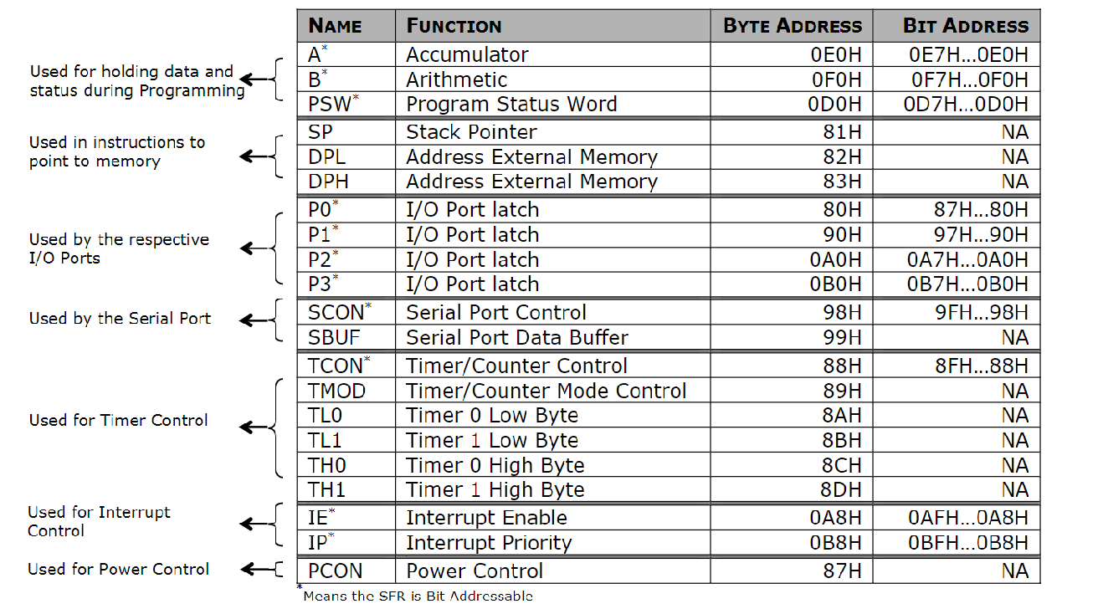
Special Function Registers (SFRs of 8051)
21 8-bit SFR’s are there in 8051

Slide 22
8051 STACK AND REGISTER BANKS
128 bytes of RAM in the 8051
assigned addresses 00 to 7FH.
The 128 bytes are divided into three different groups as follows.
32 bytes from locations 00 to 1F set aside for register banks and the stack.
16 bytes from locations 20H to 2FH set aside for bit addressable Read/Write memory.
80 bytes from locations 30H to 7FH are used for read and write storage. These 80 bytes locations of RAM are widely used for the purpose of storing data and parameters by 8051 programmers.

Slide 23
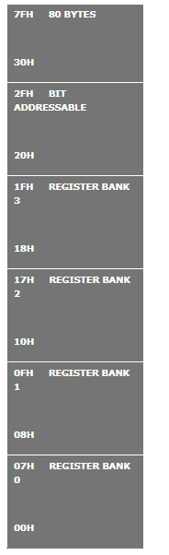
RAM ALLOCATION IN 8051

Slide 24
REGISTER BANKS IN THE 8051:
32 bytes of RAM are divided into 4 banks of registers in which each bank has 8 registers, R0 - R7.
RAM locations from 0 to 7 are set aside for bank 0 of R0 - R7.
Second bank of registers R0 - R7 starts at RAM location 08H and goes to location 0FH.
Third bank of R0-R7 starts at memory location 10H and goes to location 17H.
Fourth bank of R0-R7 starts at memory location 18H and goes to location 1FH.

Slide 25
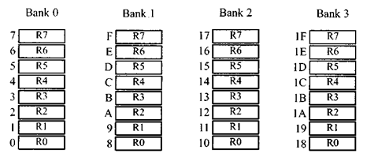
REGISTER BANKS IN THE 8051:

Slide 26
STACK IN THE 8051
stack is a section of RAM used by the CPU to store information temporarily.
this information could be data or an address.
the register used to access the stack is called the SP (stack pointer) register.
the stack pointer in the 8051 is only 8 bits wide, which means that it can take values of 00 to FFH.
When the 8051 is powered up, the SP register contains value 07.
This means that RAM location 08 is the first location used for the stack by the 8051.

Slide 27
PUSHING ONTO THE STACK
the stack pointer (SP) points to the last used location of the stack.
as data is pushed onto the stack, the stack pointer (SP) is incremented by one.
as each PUSH is executed, the contents of the register are saved on the stack and SP is incremented by 1.
to push the registers onto the stack their RAM addresses should be used.
For example, the instruction “PUSH 1″ pushes register Rl onto the stack.

Slide 28
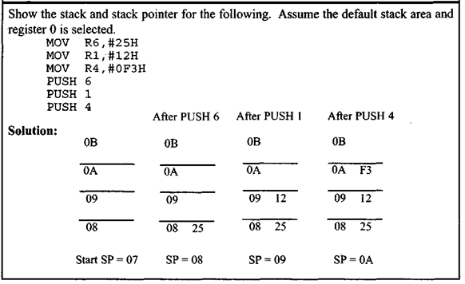
PUSHING ONTO THE STACK

Slide 29
POPPING FROM THE STACK
Popping the contents of the stack back into a given register is the opposite process of pushing.
With every pop, the top byte of the stack is copied to the register specified by the instruction and the stack pointer is decremented once

Slide 30
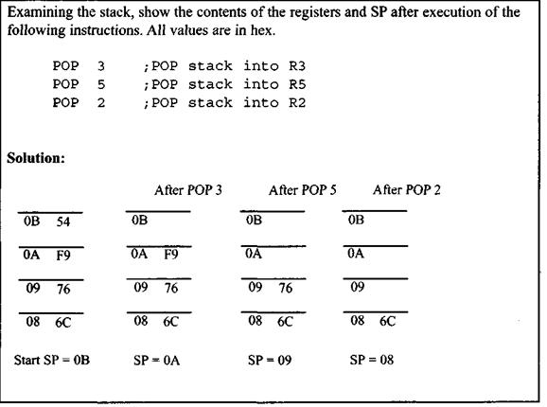
POPPING FROM THE STACK

Slide 31
8051 Interrupts
Interrupt Structure: An interrupt is an external or internal event that disturbs the microcontroller to inform it that a device needs its service.
The program which is associated with the interrupt is called the interrupt service routine (ISR) or interrupt handler.
Upon receiving the interrupt signal the Microcontroller , finish current instruction and saves the PC on stack. Jumps to a fixed location in memory depending on type of interrupt Starts to execute the interrupt service routine until RETI (return from interrupt)
Upon executing the RETI the microcontroller returns to the place where it was interrupted. Get pop PC from stack

Slide 32
8051 Interrupts
The 8051 microcontroller has FIVE interrupts in addition to Reset. They are
Timer 0 overflow Interrupt (TF0)
Timer 1 overflow Interrupt (TF1)
External Interrupt 0 (INT0)
External Interrupt 1(INT1)
Serial Port events (buffer full, buffer empty, etc)

Slide 33
8051 Interrupts
Each interrupt has a specific place in code memory where program execution (interrupt service routine) begins.
External Interrupt 0: 0003 H
Timer 0 overflow: 000B H
External Interrupt 1: 0013 H
Timer 1 overflow: 001B H
Serial Interrupt: 0023 H
(Interrupt lists above in the decreasing order of priority)

